Slide 1

Is the promise of prosperity and opportunity still alive?

Slide 2

For many, the answer feels like a resounding "No.”
Why?

Slide 3

Your Health The Silent Burden
Medical debt is growing
Rising cost of healthcare and insurance
Increasing poor/chronic health
Stress and burnout are at an all time high
Preventative healthcare can be costly

Slide 4

Time Our Most Limited Resource
People are working longer hours for less
Purchasing power is decreasing
Over 44% of Americans have a second job
Job security is disappearing
The average American spends 54 hours per year stuck in traffic
Work-life balance has become a myth

Slide 5

Finances The Great Wealth Divide
The cost of living is outpacing wages
Homeownership is slipping away
The wealth gap is growing
Retirement is becoming less attainable
Medical expenses are pushing people into bankruptcy

Slide 6

Freedom The Dream that’s Slipping Away
Most people feel trapped in their jobs
The system favors the wealthy
Debt is modern-day slavery
Lack of control over one’s future
People dream of independence but don’t know how to achieve it
The desire for travel, quality family time, and financial security remains unfulfilled for many

Slide 7

If the traditional paths to success are failing, what’s the alternative?

Slide 8

Network Marketing & Direct Sales
A proven path to take control of your future — without relying on a job, the government, or the stock market.

Slide 9

Low Barrier to Entry High Potential for Growth
No huge investment
No degrees or special skills required
Work from anywhere – No office, no commute
Work on your terms, set your own schedule and design a life you love
All you need is a laptop, phone, the internet and a willingness to take action

Slide 10

Unlimited Earning Potential A Business that Pays Your Over & Over
Your income isn’t capped by a salary
Your success is based on effort – you control your destiny
Scalability – Build a team, create leverage, and multiply your impact and your income
No job insecurity – You’re not dependent on a boss, corporation or the economy

Slide 11

Proven Systems & Mentorship for Success
You’re in business for yourself, but not by yourself – you get a proven roadmap
Personal growth = financial growth – Network marketing is built on leadership development, mindset shifts and personal empowerment
Community & mentorship – Surround yourself with successful people who lift you up and help you grow

Slide 12

Build Generational Wealth & Legacy Income
Earn money long after the initial work is done, like royalties on a best-selling book
Passive income can be willed to your family
Create financial independence for future generations
Leave a lasting impact by helping others break free from financial struggle while building a legacy of wealth and contribution

Slide 13

Who are you going to partner with?

Slide 14
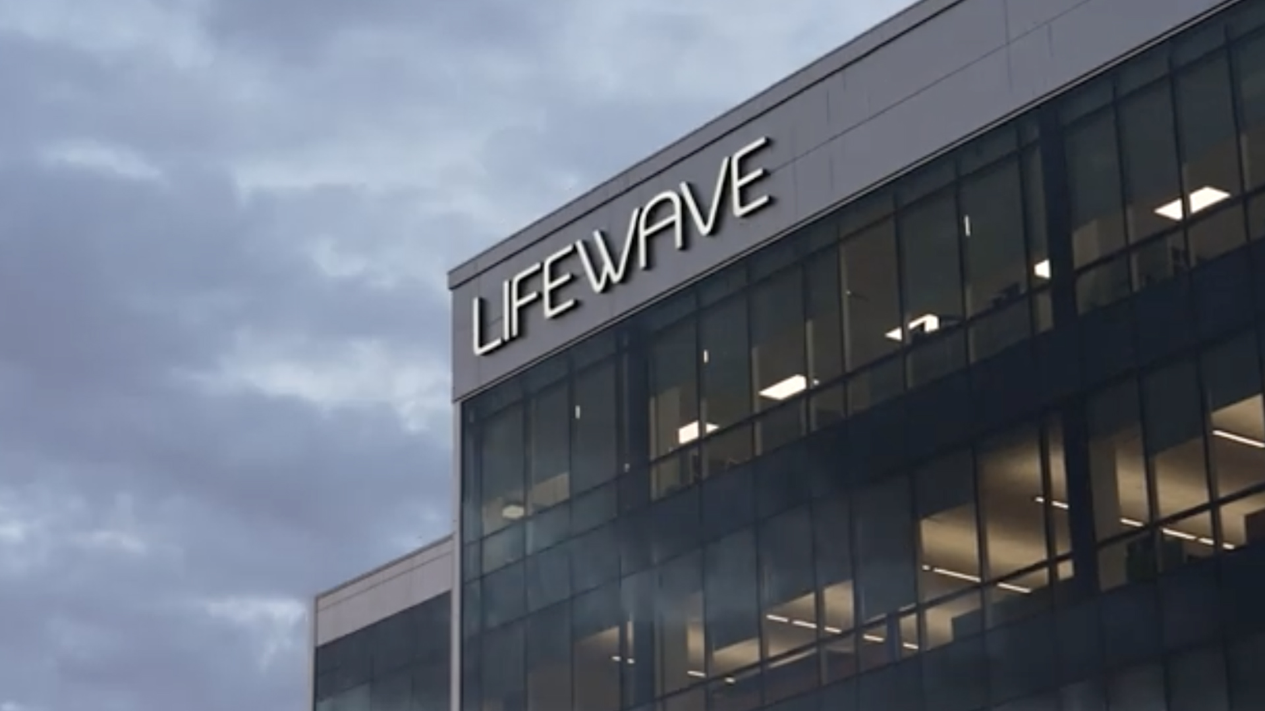
Meet LifeWave
LifeWave, Est. 2004

Slide 15

Who is Lifewave?
An innovative Health & Technology company
Founded in 2004 by David Schmidt
24+ Years of Anti-Aging & Regenerative Science
Most exclusive technology and NO competition
Debt-free company
Global distribution in over 80 countries and growing
Vertically integrated from manufacturing to the end consumer
Most generous compensation plan in the direct sales industry
Fastest growing direct sales company in the world with over 3,000% growth in the past 6 years

Slide 16

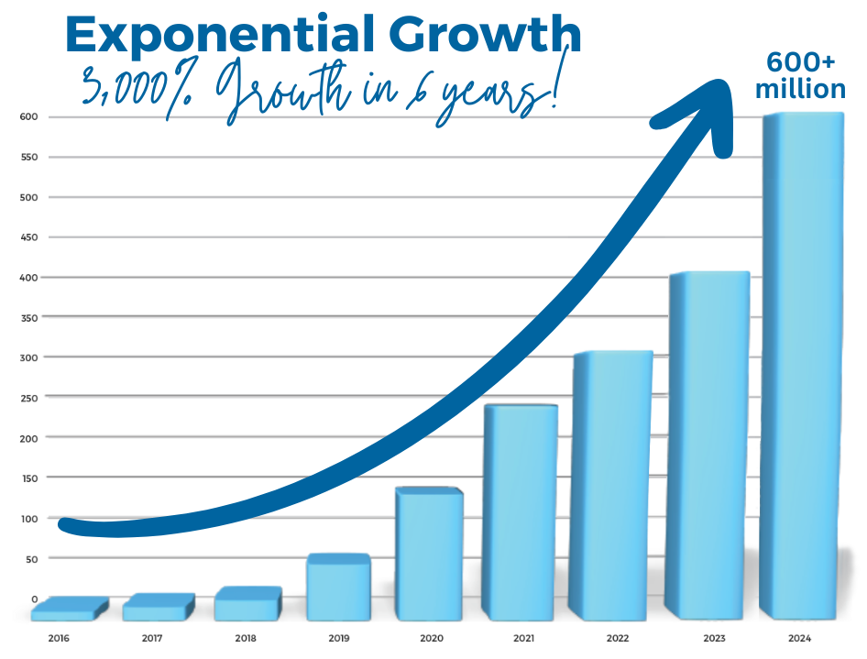
LifeWave is projected to be a billion dollar company this year!

Slide 17
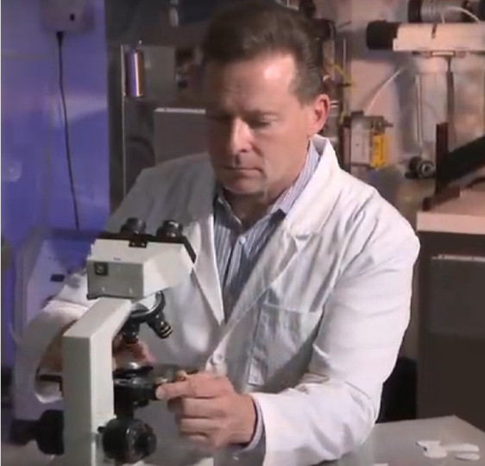
David Schmidt
Inventor/Founder & CEO
Developed light technology for U.S. Navy Seals in 2000 – Energy Enhancer
Founded LifeWave in 2004
Studied for 10 years with the most renowned stem cell university in the world – National University of Ireland
Developed a suite of light technology products
Over 130 patents & 90 clinical studies
Mission focused and partnering with humanitarian organizations, veterans, local communities and disaster relief

Slide 18

Our X39 Patches
A patented form of phototherapy
Naturally activates YOUR OWN stem cells
Support your body’s innate ability to repair and regenerate
No competition, Affordable
Proven, Patented technology
Non-invasive & drug-free
Easy to use, safe & affordable
All natural, non-invasive – just a small patch!

Slide 19
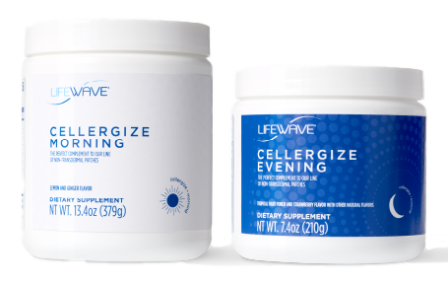
Exclusive Technology
for cellular repair and regeneration
Wearable light technology patches
Mineral powder technology
Light infused water technology
More technology is already in development!

Slide 20

Why the Health
Technology Industry

Slide 21

Health and wellness is a perpetual market always in demand – even in tough economic times
People are actively looking for natural, science-backed alternatives to traditional medicine
Chronic diseases are rising and driving demand for innovative health solutions
Helping others achieve better health creates long-term, loyal customers and a strong business foundation
People trust word-of-mouth recommendations over traditional advertising

Slide 22

Network marketing in health technology industry is the perfect combination of timing, innovation, and impact —positioning you for massive success.

Slide 23

What’s the cost if you don’t take action today?

Slide 24

Is it worth the cost of a cup of coffee a day? With a no risk 30-day guarantee

Slide 25

Three Ways to Get Started
Retail
$149.95 one month of X39
Preferred Customer
$99.95 one month of X39 (save $50)
Monthly subscription
No long-term commitment required
Risk Free 30-day Money-Back Guarantee!

Slide 26

Three Ways to Get Started
Wholesale (Brand Partner)
3 starter kits to choose from
Optional monthly subscription, but recommended
Get paid weekly when you share
and so much more!
Risk Free 30-day Money-Back Guarantee!

Slide 27

Wholesale Starter Packs
1-time introductory order
$295
(3) X39 Sleeves (90 patches)
Or Mix & Match
$535
(6) X39 Sleeves
(180 patches)
Or Mix & Match
$1750
(20) X39 Sleeves
(600 patches)
Or Mix & Match
Add a monthly subscription of X39 for $99

Slide 28


How to get the best results
The Dynamic Duo Core Pack
Stem Cell Activation (1) sleeve, 30 days
Anti-Inflammation (4) sleeves, 120 days
plus a monthly subscription of (1) X39 for $99

Slide 29

HEALTH & WEALTH TESTIMONIALS

Slide 30
Your Health, Time & Financial Freedom is Waiting
Get back with the person who invited you and get your questions answered
Commit to try X39… and with our Risk Free 30-Day Guarantee you have nothing to lose and your health to gain
Enjoy enhanced quality of life… change the trajectory of your aging and your finances
Share the good news about X39
Join our global wellness community

Slide 31

Thank you for your time!
Your journey to health and wealth starts here.
Please reach out to the person who invited you this evening.

